Slide 1
C Programming
File I/O

Slide 2
So far …
All of the
input and output
has been
keyboard and
screen

Slide 3
So far …
Data is
not permanent

Slide 4
We want …
Permanent
storage
of data

Slide 5
In order to store data permanently, we have to use files.

Slide 6
Typical Pattern
Open the file.
Do the reading or writing.
Close the file.

Slide 7
Opening a File
Done through fopen() function call

Slide 8
Prototype:
FILE *
fopen(
char *filename,
char *access);

Slide 9
FILE * is a pointer to a FILE data type
FILE is provided in stdio.h

Slide 10
ALWAYS save
the return value
from fopen()
into a FILE * variable.

Slide 11
filename
is a string that contains the name of the file you want to open

Slide 12
access
is a string indicating how you want to use the file

Slide 13
The filename Parameter
If you have a backslash in the string, you have to have another backslash with it to escape the backslash.
e.g. "\\temp\\test.txt"

Slide 14
It can be an absolute or relative name.
Absolute examples:
"\\temp\\test.txt"
"c:\\temp\\test.txt"
"g:\\my files\\test.txt"
Relative examples:
"test.txt"
"..\\test.txt"
"subdir\\testdir\\test.txt"

Slide 15
In Windows 7 (and after),
watch out for Libraries

Slide 16
The access Parameter
This is a string
that usually consists of
a letter indicating the primary operation
(and an optional suffix)

Slide 17
Primary Access Codes
Letter | Meaning
r | read-only
w | write-only
a | append-only

Slide 18
Suffixes
Suffix | Meaning
b | Binary file
+ | Both read and write access

Slide 19
Access Examples
fopen(“myfile.in”, “r”);
fopen(“myfile.out”, “w”);
fopen(“myfile.data”, “rb”);
fopen(“myfile.log”, “wb”);
fopen(“myfile.info”, “rb+”);

Slide 20
Binary vs. Text
Text files are fully readable
in a text editor
(like Notepad or the Visual Studio editor).
They contain ordinary readable characters and some control characters such as tabs, carriage returns, and line feeds.

Slide 21
Binary files can have any characters in them
Any characters can be found in a binary file, including '\0' (which is also null-termination for a string)

Slide 22
The "b" suffix in the access string indicates that you are opening a binary file.
The absence of the "b" suffix indicates that you are opening a text file.

Slide 23
There is NOT necessarily
a relationship
between a file’s extension
and
binary vs. text files.

Slide 24
Binary Files and ‘\ n’
If you open a text file as a binary file, the ‘\n’ at the end of each line is actually read as two characters:
0x0d is carriage return
0x0a is line feed
the combination is called “new line”

Slide 25
No File?
If the file you are trying to open does not exist, fopen() behaves differently depending on the access:
Access | Behaviour
r | Error
w | Creates file
a | Creates file
r+ | Error
w+ | Creates file
a+ | Creates file

Slide 26
Write vs. Append
The difference between Write access and Append access happens when the file does exist.

Slide 27
If the file to be opened exists:
opening it for Write access will destroy the existing contents.
opening it for Append access will keep the existing contents and start adding after the last byte in the file.

Slide 28
Summary of Access String Examples
r indicates open for reading as text.
w indicates open for writing as text.
a indicates open for appending as text.
r+ indicates open for both reading and writing. Operations will be done starting at the beginning of the file.
w+ indicates open for both reading and writing. The file will be created if it does not exist and the contents will be erased if it does exist.
a+ indicates open for both reading and writing. The file will be created if it does not exist and the contents will be preserved if it does exist. Writing will start at the end of the existing file content.
Any of the above examples can also have the "b" suffix, indicating that you're dealing with a binary file instead of a text file.

Slide 29
fopen() Return Values
Returns a valid pointer to a FILE struct if it succeeds.
Returns NULL if it does not succeed.

Slide 30
Always check the return value from fopen()!!!!

Slide 31
Example of fopen() Use
Declare variable:
FILE *fp = NULL;

Slide 32
Example #1
if( (fp = fopen("c:\\test.txt", "r")) == NULL )

Slide 33
Example #2
if( (fp = fopen("test.dat", "rb")) == NULL )

Slide 34
Example #3
if( (fp = fopen("..\\test.txt", "w")) == NULL )

Slide 35
Example #4
if( (fp = fopen("\\dir\\test.txt", "a")) == NULL )

Slide 36
Example #5
if( (fp = fopen("c:\\test.dat", "rb+")) == NULL )

Slide 37
Recap of fopen() Gotchas
Always:
Make sure that the access string is really a string, even if it is only one character long.
Use double-backslashes in filename paths.
Check return code for NULL.

Slide 38
The FILE * Returned
The FILE pointer returned from fopen() will be used in all subsequent file function calls until after you close the file.

Slide 39
Why?
The functions need to
know what file you're working with.

Slide 40
Using fgets() For Input From Text Files
Use fgets() as described a few weeks ago.
If fgets() run across an error or the end of the file, it will return NULL.

Slide 41
fscanf() For Text Input
There is also an fscanf() function
that behaves much like scanf()
except
that it gets the input from a text file
instead of the keyboard.

Slide 42
The parameter
before the format string
is a file pointer.

Slide 43
It has the same risks as scanf().
You are allowed to use it (since file input is more controllable than users) but you are responsible to avoid infinite loops on input field incompatibilities.

Slide 44
It still would be safer to use fgets() with sscanf().
This is the recommended method.

Slide 45
There are other input functions that you are not responsible for.

Slide 46
Output to Text Files
fprintf() is the preferred method.
It behaves exactly like printf() except that it prints text to a file instead of to the screen.

Slide 47
It takes an additional parameter
(the FILE * from the fopen() call)
before the format string.

Slide 48
It returns a negative number if there is an error.
You should check the return code in case there is a write error.
e.g. if( fprintf(fp, "%d %s\n", number, name) < 0 )

Slide 49
Errors and End of File
Two commonly used functions:
feof() takes a file pointer as a parameter and returns a non-zero number if you are at the end of file.
ferror() takes a file pointer as a parameter and returns 0 if there is no error.

Slide 50
Examples (assuming that fp contains the file pointer returned from fopen()):
if( feof(fp) != 0 ) // true if at end of file
if( ferror(fp) != 0 ) // true if there is an error
NOTE: If there is an error, you have to call clearerr(fp) to clear it.

Slide 51
Warning About feof()
When reading from a file, feof() requires a failed read operation before it finds end-of-file.

Slide 52
However, in certain circumstances, you may get failed reads sooner than you think:
Some text editors do not put a carriage return at the end of the last line in a file. Some do.
You may not be able to tell if it is there by looking at the file in a text editor.

Slide 53
fgets() and End-Of-File
The previous slide also applies to fgets().
If you are reading the last line in a file and the text editor did not put a carriage return at the end of the last line, the string you get will not have a carriage return at the end of it.
Beware of this if you try to overwrite the carriage return that is usually there.

Slide 54
Safer Way of Overwriting the '\n' From fgets()
void clearCR(char buf[ ])
{
char *whereCR = strchr(buf, '\n');
if( whereCR != NULL )
{
*whereCR = '\0';
}
}
// call clearCR, passing the array of char

Slide 55
Using fgets() to Detect End-Of-File
If fgets() returns NULL, it either has detected an error or the end of the file.

Slide 56
If fgets() has a NULL return, you will be able to then call feof() to determine if you are really at the end of the file or not.

Slide 57
You must close any file you open.
e.g. if( fclose(fp) != 0 ) // true if close fails

Slide 58
Closing the File
fclose() closes files opened with fopen().
Takes the file pointer parameter (as usual).
Returns 0 if successful.

Slide 59
Why Check For Errors?
Multiple reasons:
You may have run out of disk space.
The physical device you're working with (floppy disk, CD, USB drive) may have disappeared.

Slide 60
The network connection that you're working with may have disappeared.
You may have reached end-of-file and are detecting it without using feof().

Slide 61
Working In Visual Studio
If you are opening a file
within the Visual Studio IDE
and the file is in the current directory,
the data file is in the same
directory as your .c file

Slide 62
How About Binary Input and Output?
Getting binary input: fread()
Putting binary output: fwrite()

Slide 63
NOTE: There are no null-terminations in binary input and output since the null-termination could be a valid character in your input!

Slide 64
fread()
Prototype:
size_t fread(
void *a_ptr,
size_t element_size,
size_t n,
FILE *fp);

Slide 65
Parameters:
void *a_ptr: a pointer to a block of memory to put data into
size_t element_size and size_t n: used to determine how many bytes to get from the file
FILE *fp: pointer to the file opened with fopen()

Slide 66
element_size and n?
The two size-related parameters allow you to use structs for binary input.

Slide 67
If you want to fill in a struct variable from a binary file,
pass the size of the struct as the element_size parameter
(using sizeof)
and 1 as the n parameter.

Slide 68
If you want to fill in
an array of structs,
pass the size of the struct again but this time pass the number of elements you want to get as the n parameter

Slide 69
fread() Return Value
fread() returns the number of items that were actually successfully read in.

Slide 70
Always check the return code to see if it fully succeeded.

Slide 71
Examples of fread() Usage
Assume the following variable declarations:
struct item myStuff[80];
FILE *fp = fopen(/*something*/);
Examples:
if( fread(&myStuff[10], sizeof (struct item), 1, fp) != 1 )
Read in only element #10.
if( fread(&myStuff[0], sizeof(struct item), 80, fp) != 80 )
Read in all 80 elements.
if( fread(&myStuff[5], sizeof(struct item), 30, fp) != 30 )
Read in 30 elements, starting at #5.

Slide 72
fwrite()
fwrite() behaves much like fread().
All parameters are the same. The return value is the same.

Slide 73
The only differences are:
it writes instead of reads.
the pointer (first parameter) already contains the data to write

Slide 74
Random Access
You don't have to be stuck with always accessing a file starting at the start or end (sequential access).
You can get input from or put output to any position in the file (random access).
This is typically used with binary files.

Slide 75
NOTE: Even though random access can be used with text files, it should be understood that the character positions may be different from that expected.

Slide 76
ftell()
ftell() provides your current file position.

Slide 77
Prototype: long ftell(FILE *fp);
fp is the file pointer provided by fopen()
For binary files, it returns the offset into the file if successful or -1 if it is not.
For text files, the return value might not be meaningful.

Slide 78
This only is usable for files
that are smaller than
2,147,483,647 bytes in size
otherwise use fgetpos()

Slide 79
On many systems,
fgetpos() can handle files
that are as large as
9,223,372,036,854,775,807
(2⁶³ – 1)
bytes in size

Slide 80
(that’s nine quintillion, two hundred twenty three quadrillion, three hundred seventy two trillion, thirty six billion, eight hundred fifty four million, seven hundred seventy five thousand, eight hundred seven)

Slide 81
fseek()
fseek() repositions the pointer to do read or write operations with the file.

Slide 82
Prototype: int fseek(FILE *fp, long offset, int origin);
fp is the pointer to the file
offset is the number of bytes from origin
this can be a negative number
origin is one of the following constants:
SEEK_CUR: current position (only for binary files)
SEEK_END: end of file (only for binary files)
SEEK_SET: beginning of file
Example: fseek(fp, -10, SEEK_CUR) means "back up 10 bytes from the current position"

Slide 83
It returns 0 if successful
It returns non-zero if not successful (e.g. trying to use a negative offset with SEEK_SET)

Slide 84
You can’t have
a negative offset
that would bring you
before the start of the file

Slide 85
You can have a positive offset that would bring you past the end of the file
(it just goes ahead and moves there, filling with ‘\0’)

Slide 86
Again, this only is usable for files
that are smaller than
2,147,483,647 bytes in size
otherwise use fsetpos()

Slide 87
Viewing Binary Files
Binary files are not
properly viewable in
a text editor

Slide 88
The best way to view
a binary file
is with a third-party
binary hex editor

Slide 89
A very easy freeware program
is
xvi32
(http://www.chmaas.handshake.de/delphi/freeware/xvi32/xvi32.htm)

Slide 90
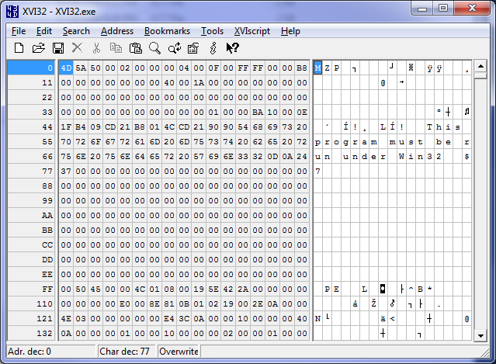

Slide 91
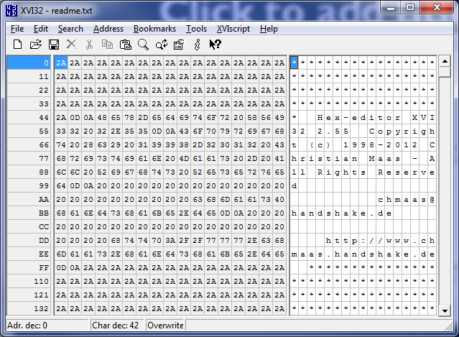
See the ‘\n’

Slide 92
It doesn’t require installation!
Just download, unzip, and run!

Slide 93
Visual Studio also supports
viewing binary files
but it differentiates
based on file extension

Slide 94
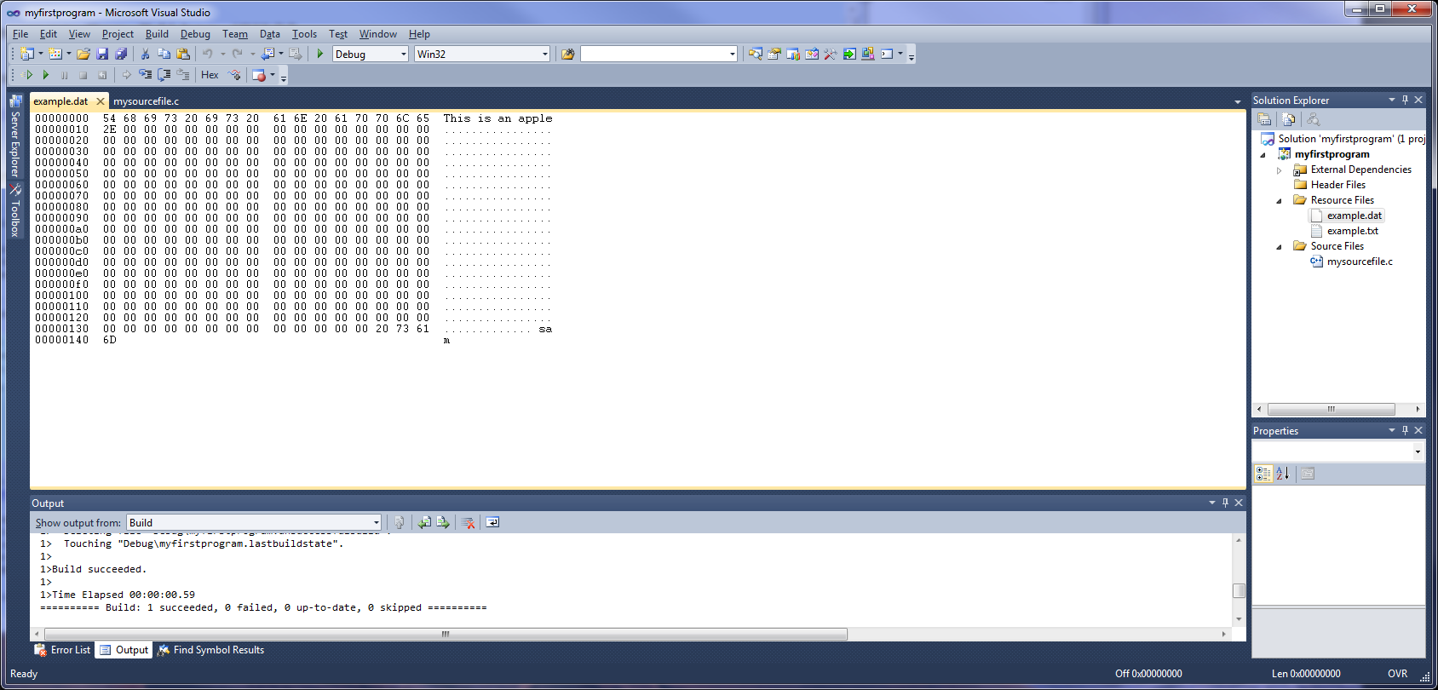

Slide 95
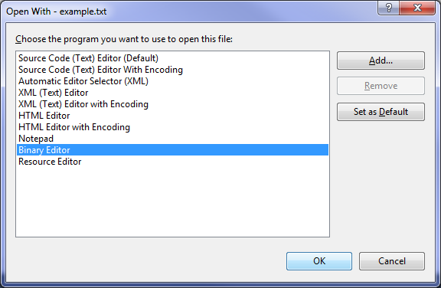

Slide 96
